Slide 1
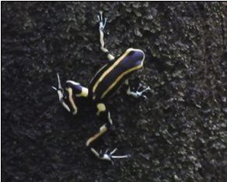
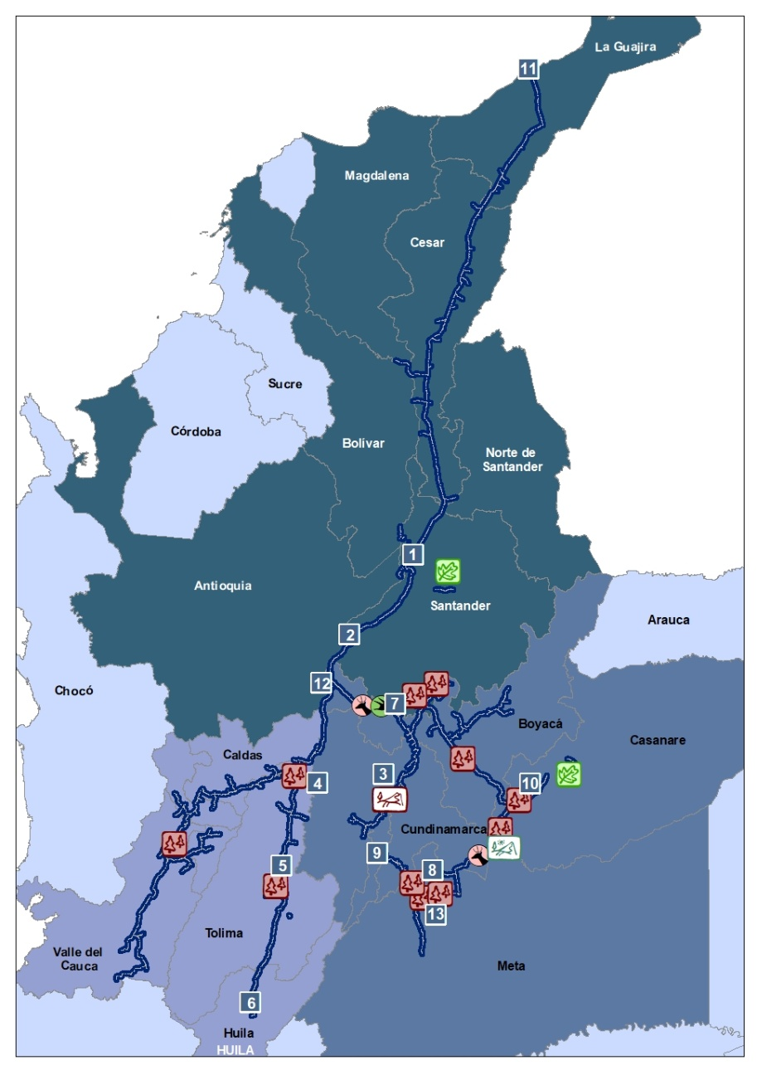
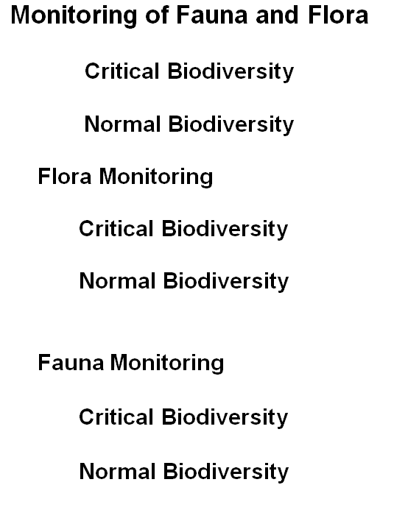
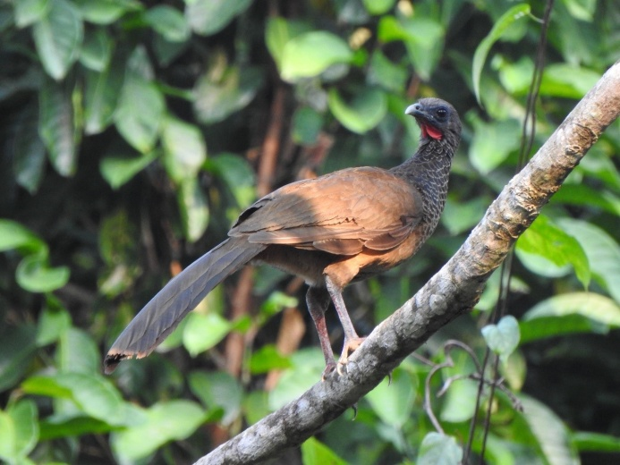
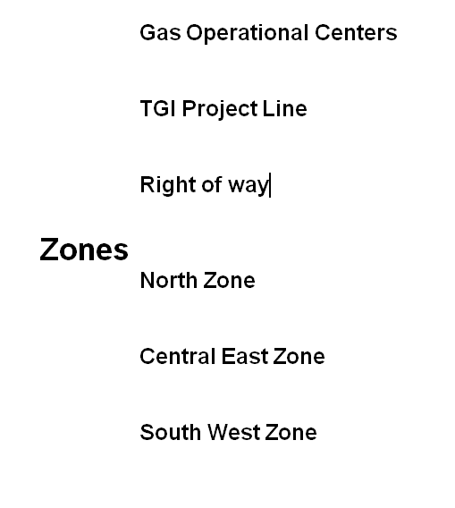
Critical Biodiversity Identified in the Infrastructure
These species classified: End (Endemic) and the IUCN Red List categories such as:Vulnerable (VU), Endangered (EN) and Critically Endangered (CR) are based on a series of five scientific criteria that assess the risk of extinction of species based on biological factors such as: The rate of regression, the size of the population, geographic area of ​​distribution and the degree of fragmentation of the population and distribution.
Yellow-banded poison dart frog (Dendrobates truncatus), endemic species of Colombia.
GAS OPERATIONAL CENTERS
ID | Name | Area (Ha)
1 | BARRANCABERMEJA OC | 0.84
2 | SEBASTOPOL OC | 0.23
3 | COGUA OC | 0.73
4 | MARIQUITA OC | 0.07
5 | GUALANDAY OC | 0.45
6 | DINA OC | 0.28
7 | LA BELLEZA OC | 3.77
8 | VILLAVICENCIO OC | 1.10
9 | USME OC | 0.21
10 | CUSIANA (CPF) OC | 77.21
11 | BALLENA OC | 1.29
12 | VASCONIA (HUB) OC | 0.36
13 | TERMO OCOA OC | 0.05
Colombian Guacharaca (orthalis columbian), endemic species of Colombia

